Slide 1
ADA C3 Assignment, Q3
-Group 03
MIT2018012,
MIT2018013,
MIT2018014,
MIT2018015,
MIT2018016

Slide 2
Drum rotates in discrete steps, α
K = 360/α sectors on surface of drum
Each sector can be either black or white
Mounted r constructive heads for reading color of sector
Input α taken
Arrangement of colors for various k is shown

Slide 3
Interpretation of the question
With given α, calculate k = 360 / α
Each platter in a hard disk has two sides/surfaces, so each platter needs two heads
Each surface is radially divided into k parts/sectors, like a pizza

Slide 4
Interpretation of the question
Each sector can have either black(0) or white(1) value (initialized randomly in the program)
For some data arrangement of black and white in the sectors, show that arrangement in specified platter and side

Slide 5
Algorithm
Simply create an array of size k
Store some possible arrangement in that array, where each index element corresponds to a sector on a platter surface
Read all values stored in array corresponding to platter number and side
Show those values to the user

Slide 6
Space and Time complexity
Upon choosing the platter and the side, the number of values that needs to be read = k
Time complexity = ϴ(k) = ϴ(1/α)
Space complexity = ϴ(2 * # platters * k)

Slide 7
For k = 16
Here, α = 360 / k = 360 / 16 = 22.5
Truncating decimal point, α = 22
Taking number of platters = 1, r = 2, since two sides for one platter
To show arrangement of colours in these 16 sectors, 16 array elements are read and printed.
ϴ(k) = ϴ(16) time taken

Slide 8
Code, class Platter
. int sector[MAX]
. int sectors
. Platter()
. Platter(int sectors)
. showsectors(int side)

Slide 9
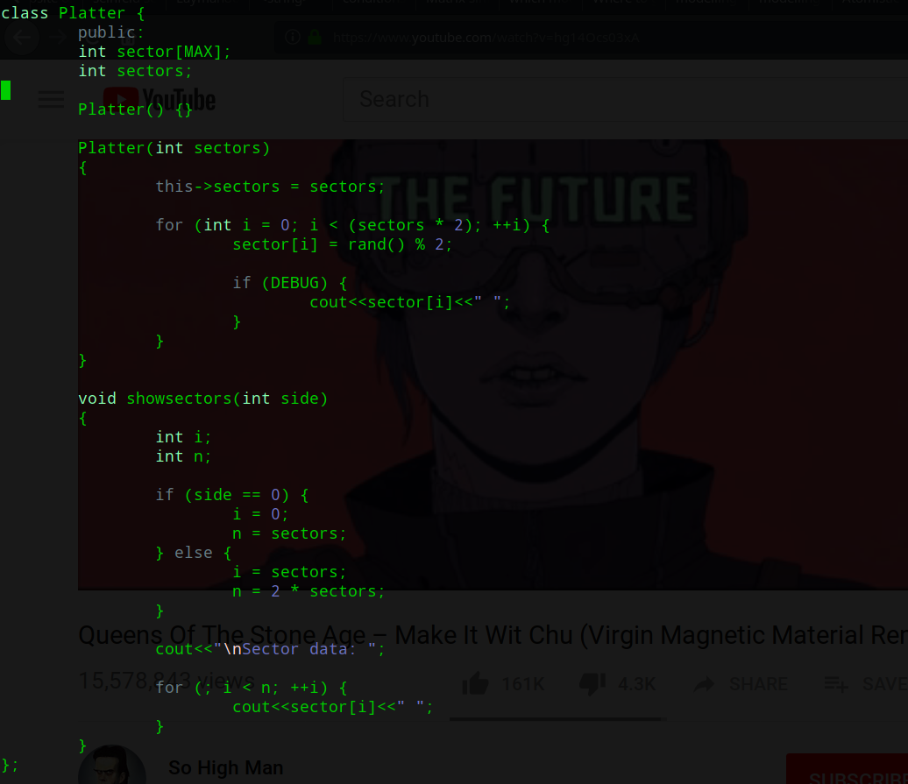
Code, class Platter

Slide 10
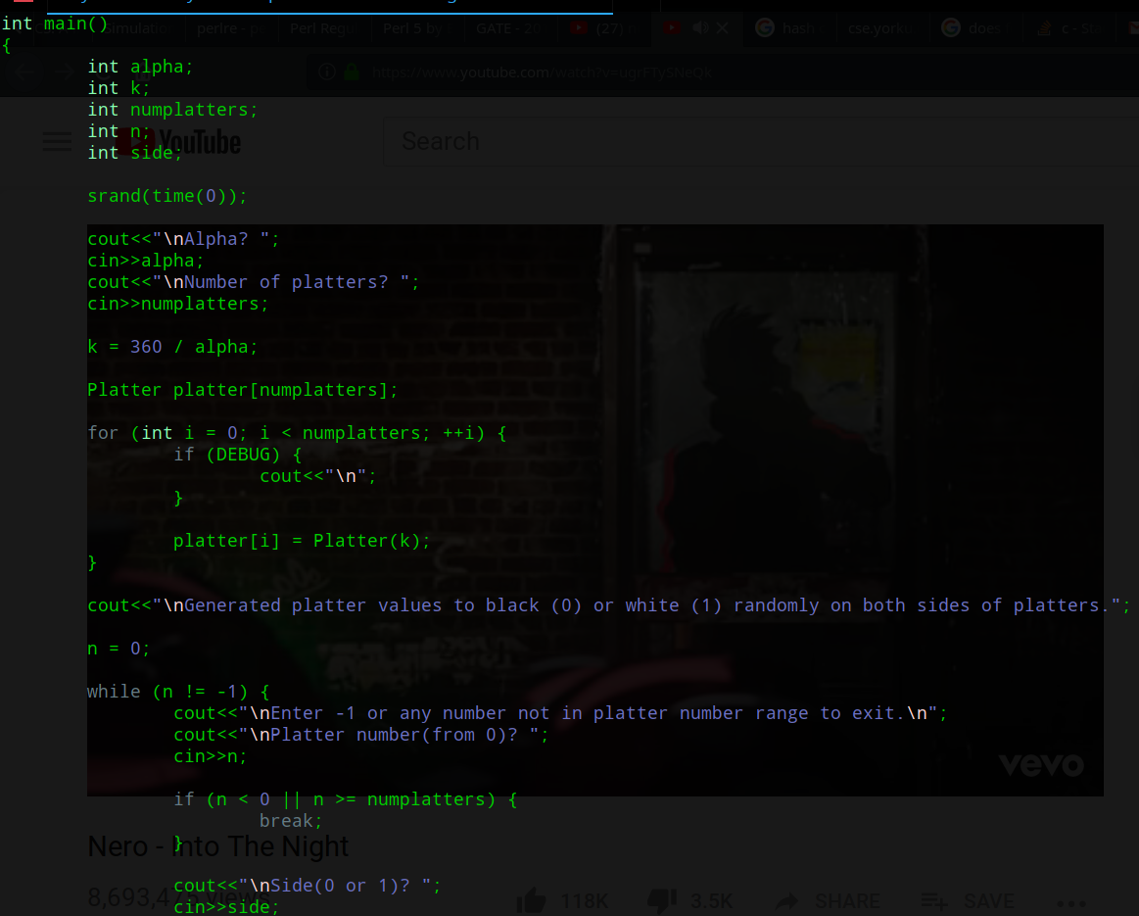
Code, main()

Slide 11
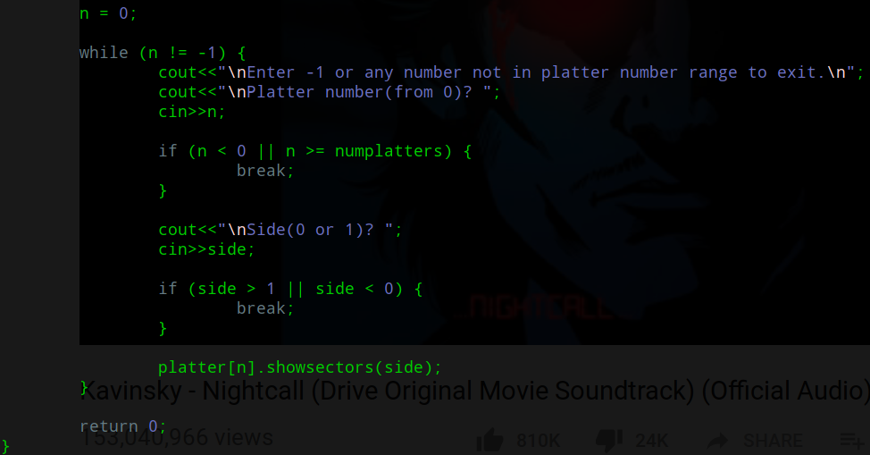
Code, main()

Slide 12
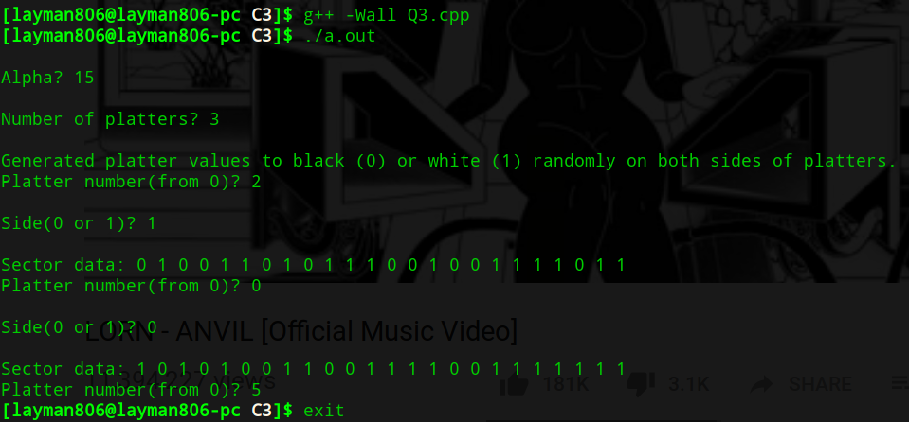
Code, execution

Slide 13
fin

